Slide 1
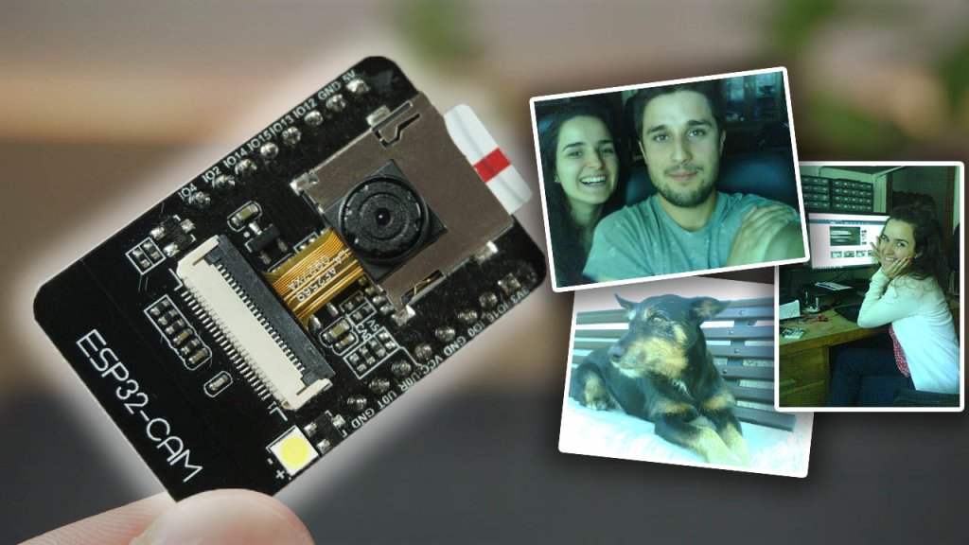

ESP32-CAM Take Photo and Save to MicroSD Card with Date and Time (timestamp)
NDONGO MAGLOIRE
Instructor: Edwin Reed-Sanchez
Final project cybersecurity CSN150

Slide 2
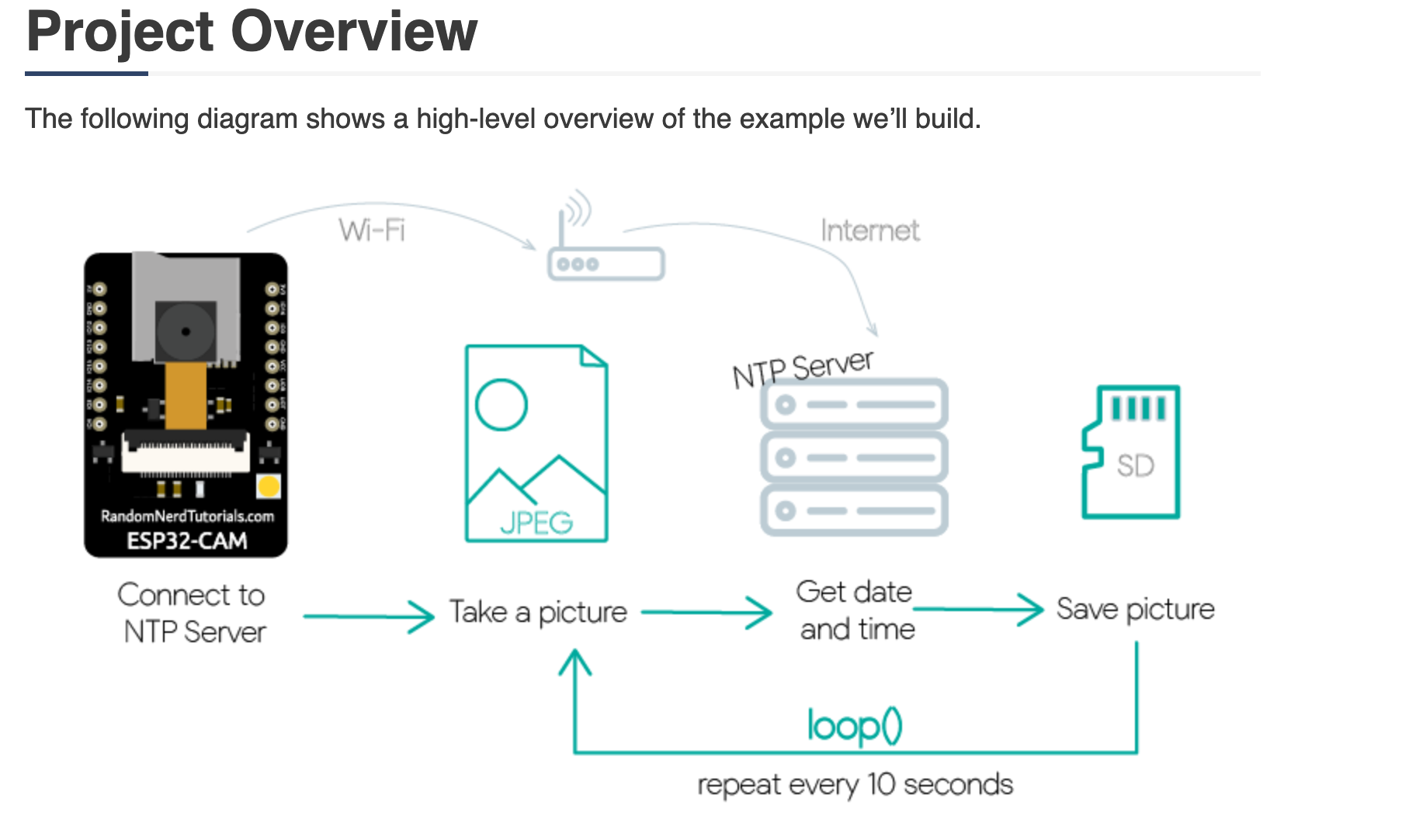
HARDWARE SETUP
Explanation of the necessary components and steps to connect ESP32-CAM to a computer:
Power Supply: The ESP32-CAM requires a stable power supply with a voltage of 5V. You can use a USB cable connected to a computer or a USB power adapter, or you can provide power through the 5V pin on the board.
Camera Connection: The ESP32-CAM board has a camera module connected to it. The camera module usually comes pre-soldered to the board. Make sure the connection is secure.
To program the ESP32-CAM, you'll need a USB-to-UART converter.
Once you have the hardware set up, you can proceed with programming the ESP32-CAM using the Arduino IDE or other supported development environments.

Slide 3
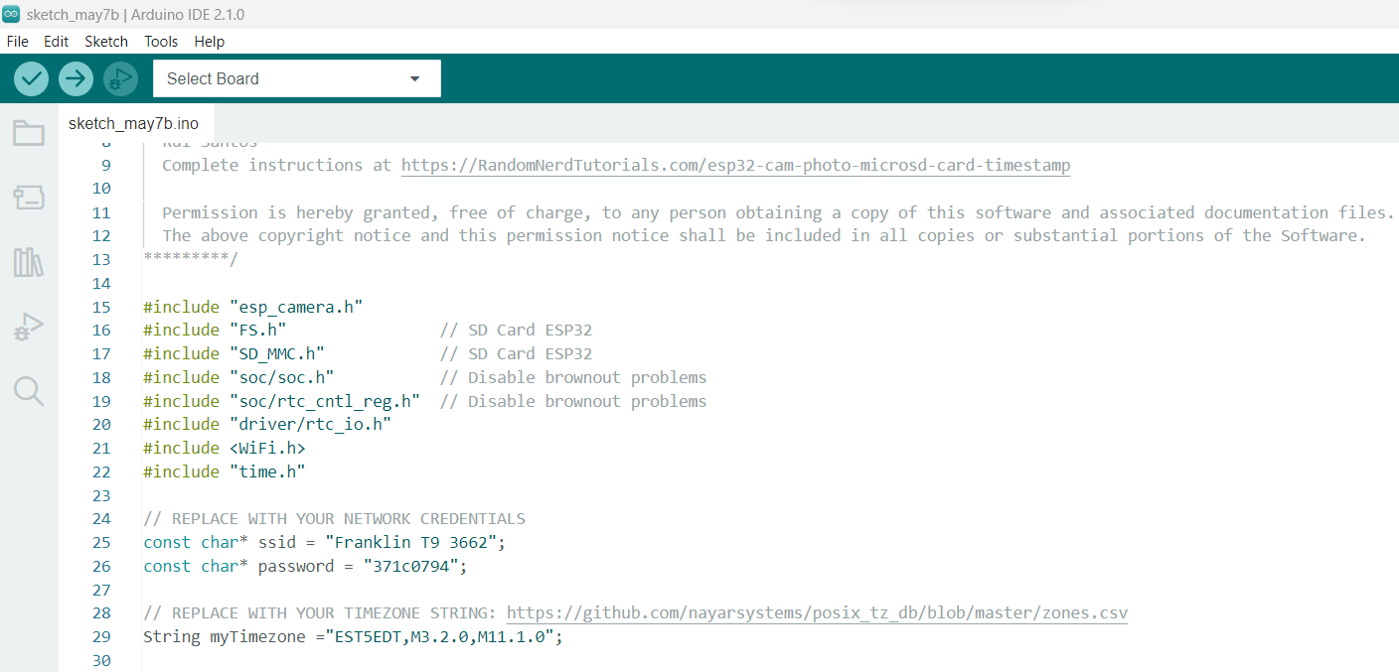
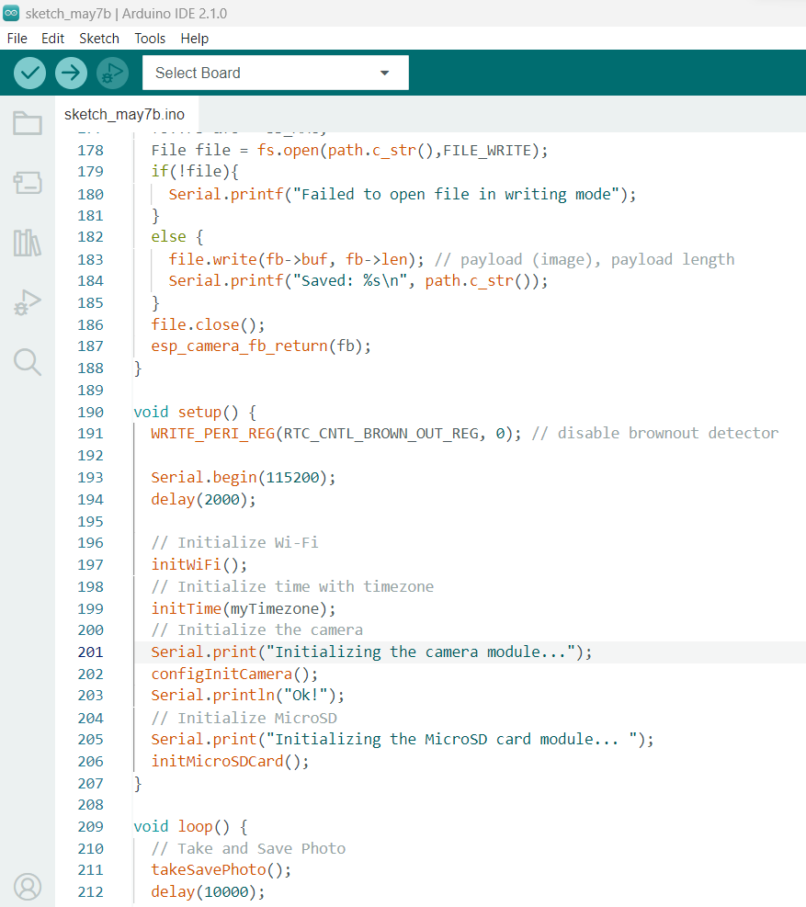
Software setup
The software setting up of the esp32-cam follow those steps:
Install the Arduino IDE: Download and install the Arduino IDE from the official Arduino website (https://www.arduino.cc/en/software). Make sure you have the latest version installed.
Add ESP32 Board Support: Open the Arduino IDE and go to "File" -> "Preferences." In the "Additional Boards Manager URLs" field, enter the following URL and click "OK":
Install ESP32 Board: Go to "Tools" -> "Board" -> "Boards Manager." In the search bar, type "esp32." Look for "esp32 by Espressif Systems" and click on the install button. This will download and install the ESP32 board package.
Camera Library Installation: To work with the ESP32-CAM's camera module, you'll need to install the camera library. Go to "Sketch" -> "Include Library" -> "Manage Libraries." In the library manager, search for "esp32cam" and install the library called "ESP32 Camera

Slide 4
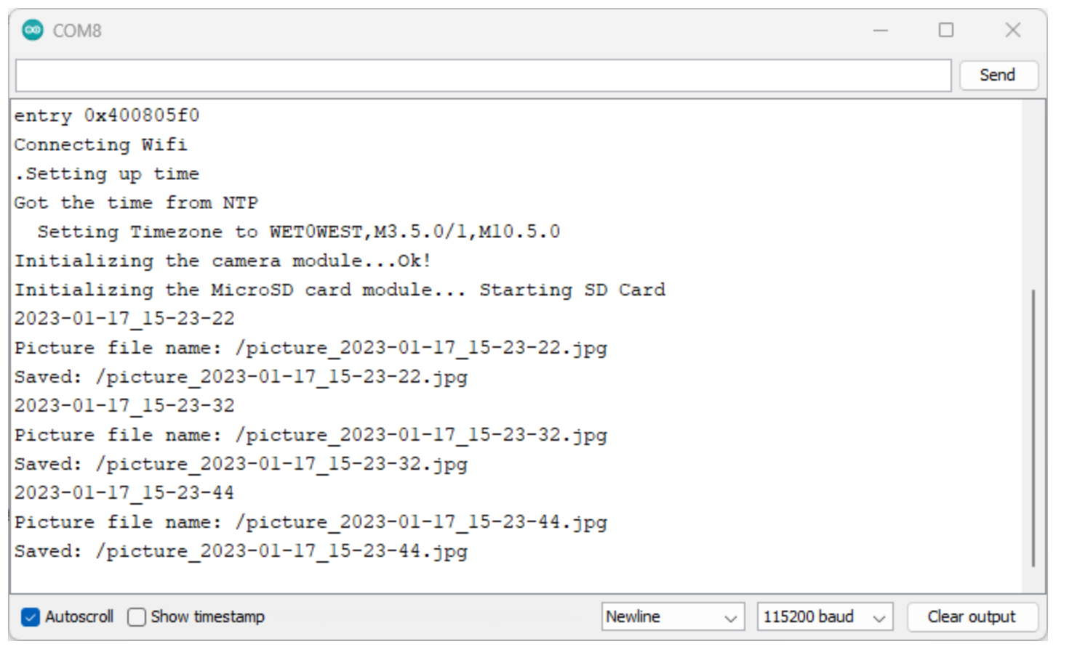
Taking A Photo with esp32- cam
The photos should have the date and time in its name. For example: or could be any name.
picture_2023-01-17_17-31-40.jpg
This means that this picture was taken on:
Year: 2023
Month: 01 (January)
Day: 17th
Time: 17:31:40 (5:31:40 PM)

Slide 5
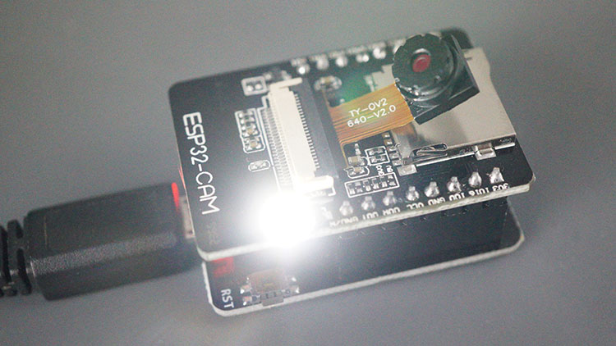
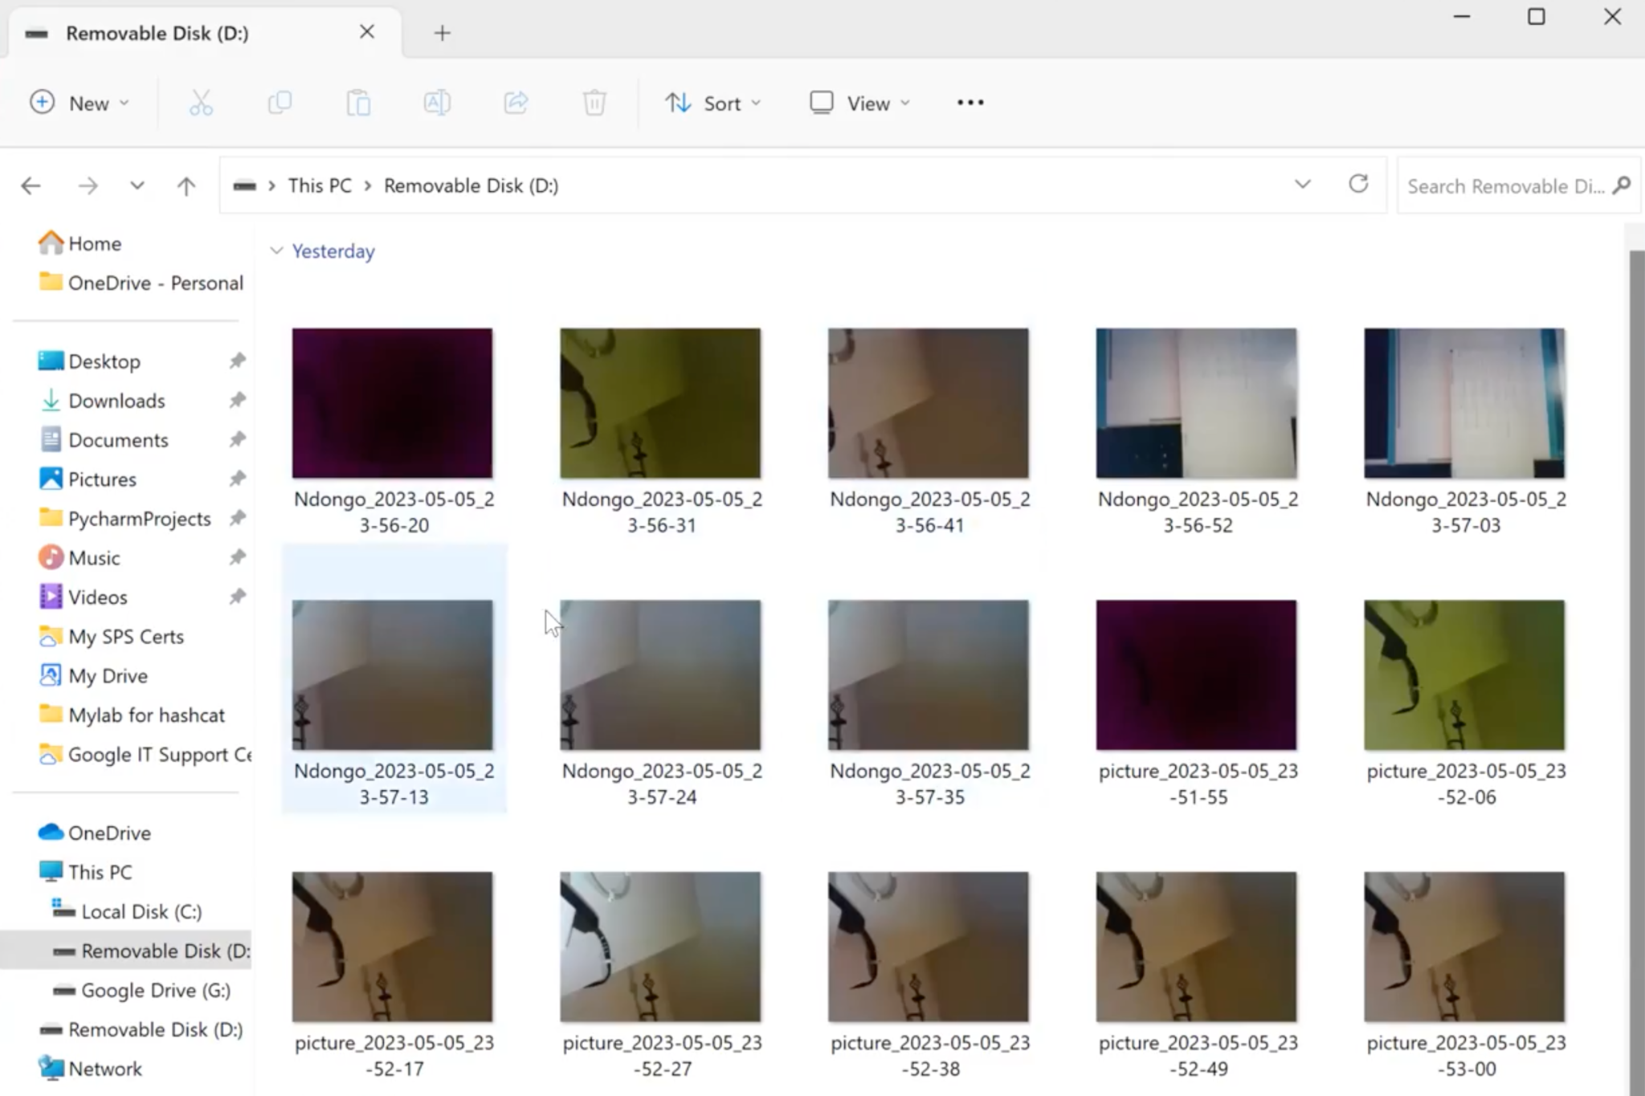
Wrapping Up
Every 10 seconds, the flash will go on
In this project, we learned how to request the date and time (with the correct timezone and daylight saving time) from the internet using the ESP32-CAM and use that information to name your pictures. This way, you know what time and date a certain picture was taken, and you don’t have to worry about overwriting photos on the microSD card.
Here is my result photos:

